Slide 1
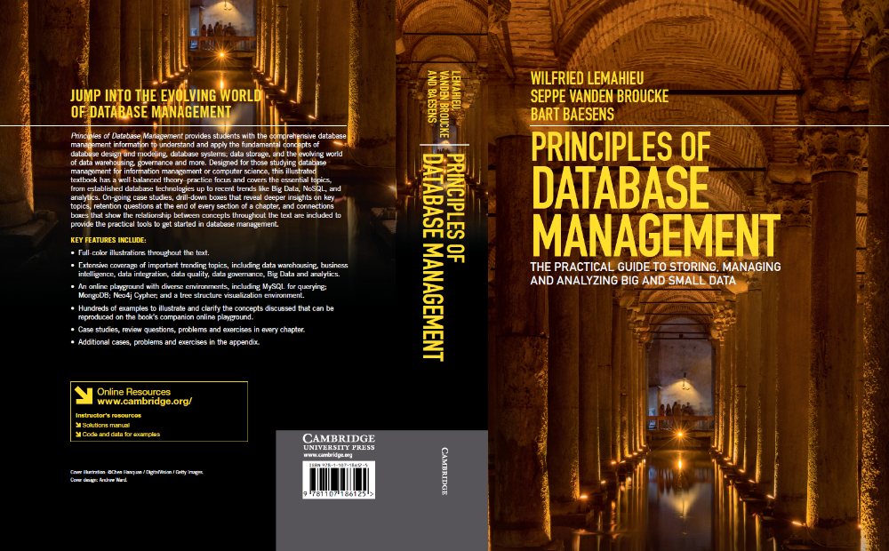
Fundamental Concepts of Database Management
www.pdbmbook.com

Slide 2
Introduction
Applications of Database Technology
Key definitions
File versus Database Approach to Data Management
Elements of a Database System
Advantages of Database Systems and Database Management

Slide 3
Applications of Database Technology
Storage and retrieval of traditional numeric and alphanumeric data in an inventory application
Multimedia applications (e.g., YouTube, Spotify)
Biometric applications (e.g., fingerprints, retina scans)
Wearable applications (e.g., FitBit, Apple Watch)
Geographical Information Systems (GIS) applications (e.g., Google Maps)
Sensor applications (e.g., nuclear reactor)
Big Data applications (e.g., Walmart)
Internet of Things (IoT) applications (e.g., Telematics)

Slide 4
Key definitions
A database can be defined as a collection of related data items within a specific business process or problem setting
  has a target group of users and applications
A Database Management System (DBMS), is the software package used to define, create, use and maintain a database
  consists of several software modules
The combination of a DBMS and a database is then often called a database system

Slide 5
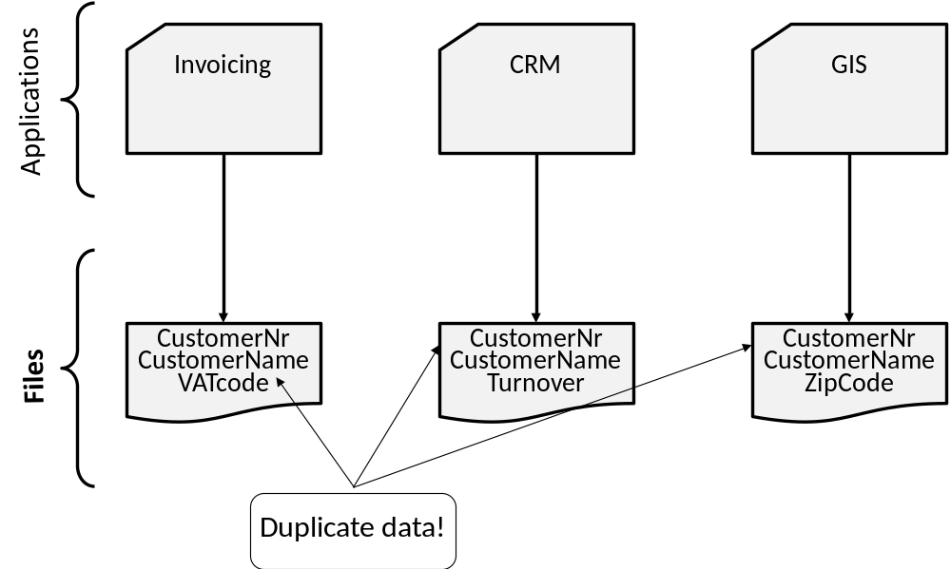
File versus Database Approach to Data Management

Slide 6
File versus Database Approach to Data Management
File approach
  duplicate or redundant information will be stored
  danger of inconsistent data
  strong coupling between applications and data
  hard to manage concurrency control
  hard to integrate applications aimed at providing cross-company services

Slide 7
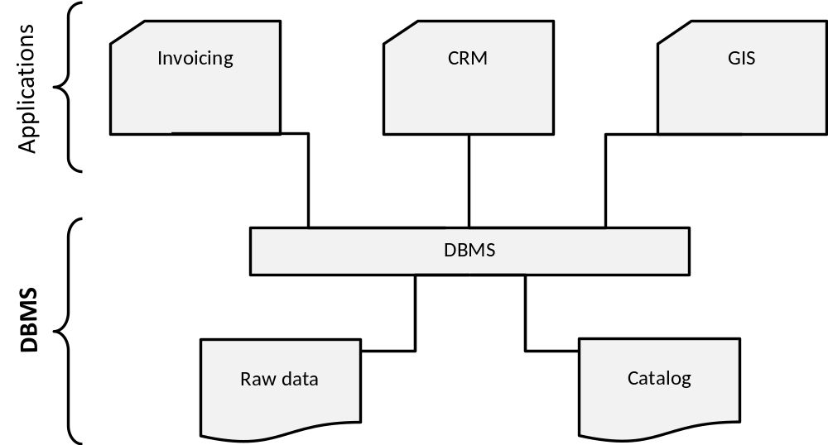
File versus Database Approach to Data Management

Slide 8
File versus Database Approach to Data Management
Database approach
  superior to the file approach in terms of efficiency, consistency and maintenance
  loose coupling between applications and data
  facilities provided for data querying and retrieval

Slide 9
File versus Database Approach to Data Management
File approach
Procedure FindCustomer;
begin
open file Customer.txt;
Read(Customer)
While not EOF(Customer)
If Customer.name='Bart' then
display(Customer);
EndIf
Read(Customer);
EndWhile;
End;
Database approach (SQL)
SELECT *
FROM Customer
WHERE
name = 'Bart'

Slide 10
Elements of a Database System
Database model versus instances
Data Model
The Three Layer Architecture
Catalog
Database Users
Database Languages

Slide 11
Database model versus instances
Database model or database schema provides the description of the database data at different levels of detail and specifies the various data items, their characteristics and relationships, constraints, storage details, etc.
  specified during database design and not expected to change too frequently
  stored in the catalog
Database state represents the data in the database at a particular moment
  also called the current set of instance
  typically changes on an ongoing basis

Slide 12
Database model versus instances
Database model
Student (number, name, address, email)
Course (number, name)
Building (number, address)

Slide 13
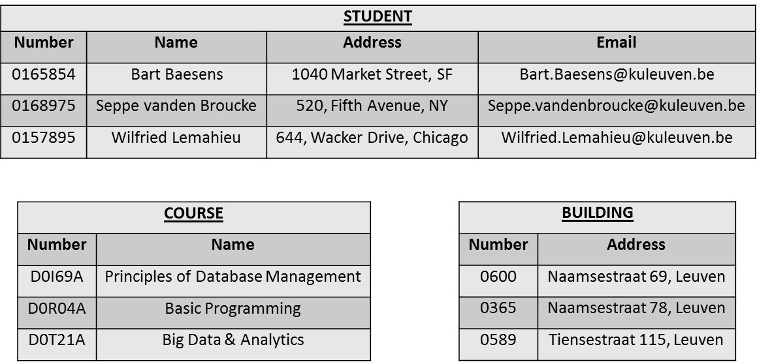
Database model versus instances
Database state

Slide 14
Data Model
A database model is comprised of different data models, each describing the data from different perspectives
A data model provides a clear and unambiguous description of the data items, their relationships and various data constraints from a particular perspective

Slide 15
Data Model
A conceptual data model provides a high-level description of the data items with their characteristics and relationships
  communication instrument between information architect and business user
  should be implementation independent, user-friendly, and close to how the business user perceives the data
  usually represented using an Enhanced-Entity Relationship (EER) model, or an object-oriented model
Logical data model is a translation or mapping of the conceptual data model towards a specific implementation environment
  can be a hierarchical, CODASYL, relational, object-oriented, extended relational, XML or NoSQL model

Slide 16
Data Model
Logical data model can be mapped to an internal data model that represents the data’s physical storage details
  clearly describes which data is stored where, in what format, which indexes are provided to speed up retrieval, etc.
  highly DBMS specific
External data model contains various subsets of the data items in the logical model, also called views, tailored towards the needs of specific applications or groups of users

Slide 17
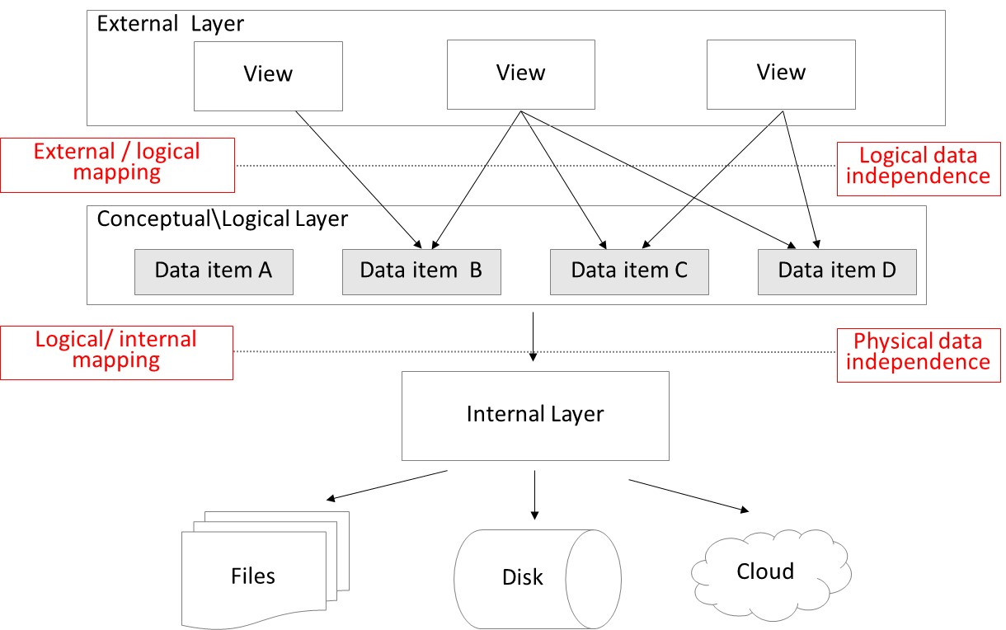
The Three Layer Architecture
physical data + logical data independence!

Slide 18
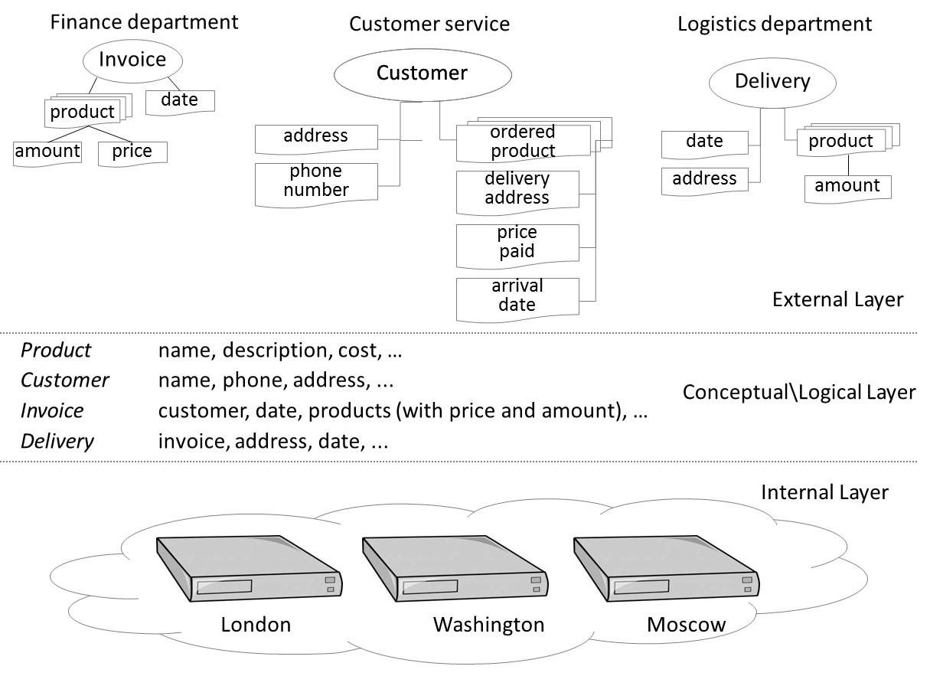
The Three Layer Architecture

Slide 19
Catalog
Heart of the DBMS
Contains the data definitions, or metadata, of your database application
Stores the definitions of the views, logical and internal data models, and synchronizes these three data models to make sure their consistency is guaranteed

Slide 20
Database Users
Information architect designs the conceptual data model
  closely interacts with the business user
Database designer translates the conceptual data model into a logical and internal data model
Database administrator (DBA) is responsible for the implementation and monitoring of the database
Application developer develops database applications in a programming language such as Java or Python
Business user will run these applications to perform specific database operations

Slide 21
Database Languages
Data Definition Language (DDL) is used by the DBA to express the database's external, logical and internal data models
  definitions are stored in the catalog
Data Manipulation Language (DML) is used to retrieve, insert, delete, and modify data
  DML statements can be embedded in a programming language, or entered interactively through a front-end querying tool
Structured Query Language (SQL) offers both DDL and DML statements for relational database systems

Slide 22
Advantages of Database Systems and Database Management
Data Independence
Database Modelling
Managing Structured, Semi-Structured and Unstructured Data
Managing Data Redundancy
Specifying Integrity Rules
Concurrency Control
Backup and Recovery Facilities
Data Security
Performance Utilities

Slide 23
Data Independence
Data independence implies that changes in data definitions have minimal to no impact on the applications
Physical data independence implies that neither the applications, nor the views or logical data model must be changed when changes are made to the data storage specifications in the internal data model
  DBMS should provide interfaces between logical and internal data models
Logical data independence implies that software applications are minimally affected by changes in the conceptual or logical data model
  views in the external data model will act as a protective shield
  DBMS must provide interfaces between conceptual/logical and external layer

Slide 24
Database Modelling
A data model is an explicit representation of the data items together with their characteristics and relationships
A conceptual data model should provide a formal and perfect mapping of the data requirements of the business process and is made in collaboration with the business user
  translated into logical and internal data model
Important that a data model’s assumptions and shortcomings are clearly documented

Slide 25
Managing Structured, Semi-Structured and Unstructured Data
Structured data
  can be described according to a formal logical data model
  ability to express integrity rules and enforce correctness of data
  also facilitates searching, processing and analyzing the data
  E.g., number, name, address and email of a student
Unstructured data
  no finer grained components in a file or series of characters that can be interpreted in a meaningful way by a DBMS or application
  E.g., document with biographies of famous NY citizens
  Note: volume of unstructured data surpasses that of structured data

Slide 26
Managing Structured, Semi-Structured and Unstructured Data
Semi-structured data
  data which does have a certain structure, but the structure may be very irregular or highly volatile
  E.g., individual users’ webpages on a social media platform, or resume documents in a human resources database

Slide 27
Managing Data Redundancy
Duplication of data can be desired in distributed environments to improve data retrieval performance
DBMS is now responsible for the management of the redundancy by providing synchronization facilities to safeguard data consistency
Compared to the file approach, the DBMS guarantees correctness of the data without user intervention

Slide 28
Specifying Integrity Rules
Syntactical rules specify how the data should be represented and stored
  E.g., customerID is an integer; birthdate should be stored as month, day and year
Semantical rules focus on the semantical correctness or meaning of the data
  E.g., customerID is unique; account balance should be > 0; customer cannot be deleted if he/she has pending invoices
Integrity rules are specified as part of the conceptual\logical data model and stored in the catalog
  directly enforced by the DBMS instead of applications

Slide 29
Concurrency Control
DBMS has built in facilities to support concurrent or parallel execution of database programs
Key concept is a database transaction
  sequence of read/write operations considered to be an atomic unit in the sense that either all operations are executed or none at all
Read/write operations can be executed at the same time by the DBMS
DBMS should avoid inconsistencies!

Slide 30
Concurrency Control
Lost update problem
Time | T1 | T2 | balance
t1 |  | Begin transaction | $100
t2 | Begin transaction | read(balance) | $100
t3 | read(balance) | balance=balance+120 | $100
t4 | balance=balance-50 | write(balance) | $220
t5 | write(balance) | End transaction | $50
t6 | End transaction |  | $50

Slide 31
Concurrency Control
DBMS must support ACID (Atomicity, Consistency, Isolation, Durability) properties
  Atomicity requires that a transaction should either be executed in its entirety or not all
  Consistency assures that a transaction brings the database from one consistent state to another
  Isolation ensures that the effect of concurrent transactions should be the same as if they would have been executed in isolation
  Durability ensures that the database changes made by a transaction declared successful can be made permanent under all circumstances

Slide 32
Backup and Recovery Facilities
Backup and recovery facilities can be used to deal with the effect of loss of data due to hardware or network errors, or bugs in system or application software
Backup facilities can either perform a full or incremental backup
Recovery facilities allow to restore the data to a previous state after loss or damage occurred

Slide 33
Data Security
Data security can be enforced by the DBMS
Some users have read access, whilst others have write access to the data (role-based functionality)
  E.g., vendor managed inventory (VMI)
Data access can be managed via logins and passwords assigned to users or user accounts
Each account has its own authorization rules that can be stored in the catalog

Slide 34
Performance Utilities
Three KPIs of a DBMS are
  response time denoting the time elapsed between issuing a database request and the successful termination thereof
  throughput rate representing the transactions a DBMS can process per unit of time
  space utilization referring to the space utilized by the DBMS to store both raw data and metadata
DBMSs come with various types of utilities aimed at improving these KPIs
  E.g., utilities to distribute and optimize data storage, to tune indexes for faster query execution, to tune queries to improve application performance, or to optimize buffer management

Slide 35
Conclusions
Applications of Database Technology
Key definitions
File versus Database Approach to Data Management
Elements of a Database System
Advantages of Database Systems and Database Management

Slide 36
More information?
www.pdbmbook.com

